Slide 1
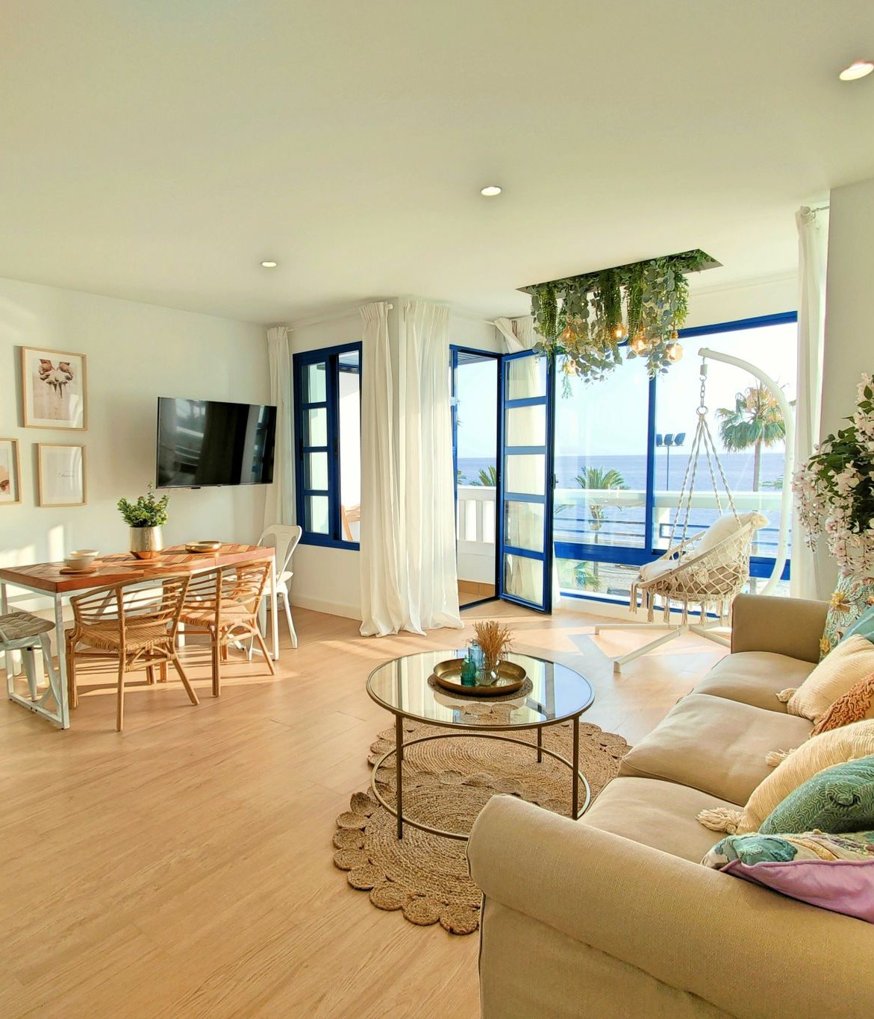

WORKING DOCUMENT
Booking without visiting
Trust at a distance, booking journey audit and product redesign
Readout
7 October 2026
Mayare Ouassou, UX research
Personal project, not affiliated with Spotahome. Research on public data; interviews, tests and survey prepared, not run.
Photo : Pexels

Slide 2
Contents
01
Context and method
page 6
02
Discover
page 11
03
Define
page 32
04
Develop · Deliver
page 35
05
Validate and next steps
page 44
Spotahome · Booking without visiting · Working document
By Mayare Ouassou | 2

Slide 3
What's at stake - Trustpilot, 16,529 reviews
In one year, the share of one-star reviews has doubled
4.38 → 3.16
average rating: reviews over a year old, then last 30 days
3,612
reviews a year at last month's pace, against 2,131 over the last 12 months
Share of one-star reviews by period (Trustpilot's public counters, taken on 7 October 2026)
379
Trustpilot also flags that Spotahome collected incentivised reviews: the overall 3.5 score hides a recent decline.
fewer one-star reviews a year if the share went back to its former level
Spotahome · Booking without visiting · Working document
By Mayare Ouassou | 3

Slide 4
The central insight - what every method says
Spotahome sells a promise you can only check after paying
The price
The proof
The rule
The total for the stay doesn't exist before paying: 52 s, 8 clicks and 5 sums to rebuild it (KLM). 67% of listings push fees outside the summary.
"Verified" says neither how nor when: 17 months in median, and the job described is a photographer's. You discover the home on arrival.
The guarantee promises with certainty, the terms add conditions and judge alone: what gives a right is discovered when things go wrong.
And after paying, no one. 49% of negative reviews mention silence; 92% of one-star stories have no resolution; trust breaks on integrity (76.5%) before benevolence. Tenants pay first, check later, and are left alone to dispute.
Hence the redesign concept, "Nothing hidden": make the promise checkable before paying, and keep a named person afterwards.
Spotahome · Booking without visiting · Working document
By Mayare Ouassou | 4

Slide 5
Summary - the evidence in five figures
What users blame isn't the home, it's what comes after paying
49 %
of 1 and 2-star reviews mention silence after paying. It is the first complaint, ahead of the gap with the listing (26%).
6 270 €
the real cost of 3 months on a listing shown as "€1,800/month". The interface never adds up the total.
17 months
the median age of the verification shown on 39 "Verified" listings. The label says neither when nor how.
"minor"
is how the terms qualify a higher rent than listed or a landlord living on site.
0 %
of the brand's 203 public replies are signed by a person, while 17.5% of positive reviews thank an agent by name.
Proposal: "Nothing hidden", a redesign that shows the total, dates the verification, shows the rule before paying and keeps a named person after payment.
Spotahome · Booking without visiting · Working document
By Mayare Ouassou | 5

Slide 6
01
Context and method
A platform that sells trust at a distance, studied with social-science tools.
· The platform and the research question
· The research set-up: 25 methods
· The fieldwork, day by day
Spotahome · Booking without visiting · Working document
By Mayare Ouassou | 6

Slide 7
Context - the platform
Renting for a few months a home you'll only see on arrival
Spotahome rents furnished homes for 1 to 12 months, mostly to exchange students, interns and relocating employees. There are no viewings: homecheckers film the home, the platform holds the first payment and passes it to the landlord after arrival, and a guarantee promises to settle problems reported within 24 hours.
On Trustpilot the score is 3.5 from 17,712 reviews: 62% five stars, 19.5% one star, very few in between. Users love it or feel trapped.
RESEARCH QUESTION
How do people trust a home they have never seen? What devices does the platform set up, and what happens to them when the experience leaves the planned frame?
Why this field: Spotahome polishes search and video, but the interface says little about money and rules. That is where trust is decided.
Spotahome · Booking without visiting · Working document
By Mayare Ouassou | 7

Slide 8
Method - research set-up
Social sciences: fifteen methods that work on traces
Method
Reference
Material
Method
Reference
Material
Netnography
Kozinets
716 reviews (500 Trustpilot, 216 App Store), 8 languages, hand-coded on 26 codes
Content analysis
Karpik
60 listings in 3 cities: badges, dates, fees, landlords
Visual semiology
Barthes
Listing photos as staging
Ideal types
Weber
k-medoids clustering on 347 negative reviews: 5 profiles
Qualification
Boltanski, Thévenot
How the terms name each problem
Lexical analysis
log-likelihood
Words specific to negative and positive reviews
Mapping
Latour, Venturini
Actors, devices and friction points
Temporalities
Lag between experience and review; trend 2017-2026
Benchmark
DiMaggio, Powell
3 competitors: one shared device, isomorphism
Interaction order
Goffman
203 public brand replies
Ergonomic audit
Bastien, Scapin
34 findings crossed with the reviews
Walkthrough
Light, Burgess, Duguay
Real journey up to the sign-up wall, help centre, terms
Interview, test, survey
Kaufmann
Prepared, not run: 8 + 8 people, 300 answers targeted
Script
Akrich
What the interface expects, what users do
Discourse analysis
Flesch-Kandel
Modality and readability: Guarantees page against terms
Spotahome · Booking without visiting · Working document
By Mayare Ouassou | 8

Slide 9
Method - ergonomic psychology and measures
Ten more measures, carried through to results, without participants
Method
Reference
Material
Method
Reference
Material
Task analysis (HTA)
Annett, Duncan
Break down the task "find the cost"
Decision biases
Morwitz, Kahneman, Cialdini
Partitioned price, anchoring, social proof
KLM model
Card, Moran, Newell
Time and clicks, current site against redesign
Accessibility
WCAG 2.1, axe-core
5 pages, desktop and mobile
Trust model
Mayer, Davis, Schoorman
716 reviews reread
Cognitive load
Sweller, Cowan
Items to hold to do the sum
Cognitive walkthrough
Wharton, Polson
10 steps, 4 questions each
Service blueprint
Shostack, Bitner
Front stage, backstage, reviews by moment
Dark patterns
Gray, Mathur
60 listings, full text
Narrative analysis
Labov, Waletzky
60 one-star stories hand-coded
Plus two document readings: homechecker job ads, and the terms compared with the French Consumer Code's unfair-clause lists. All data is in the "Analyses" workbook.
Spotahome · Booking without visiting · Working document
By Mayare Ouassou | 9

Slide 10
Method - fieldwork
Three days of online fieldwork, kept in a field notebook
5 October
6 October
7 October
Collection
Reading and coding
Analyses
500 Trustpilot reviews (100 per rating) and 216 App Store reviews in 7 countries. Real booking journey, stopped at the sign-up wall: no account was created.
Full reading and hand coding. A first keyword pass only found 53% of the codes: dropped. Terms (31,644 words), help centre, 203 brand replies.
60 listings, photos, words, timing, discourse. Sampling error found: 7 "listings" were category pages, replaced and figures recomputed.
Stance: observe without intervening. The field notebook records descriptive, analytical and reflexive notes for each session (Beaud and Weber), including errors and how they were fixed.
Spotahome · Booking without visiting · Working document
By Mayare Ouassou | 10

Slide 11
02
Discover
What reviews, the brand, the rules, the listings and competitors say.
· Netnography, ideal types, words and timing
· Ergonomic psychology: KLM, walkthrough, dark patterns, accessibility
· Trust, blueprint, stories, terms
· Brand replies
· Price, rules and discourse
· Listings and photos
· Benchmark and actors
· Bastien and Scapin audit
Spotahome · Booking without visiting · Working document
By Mayare Ouassou | 11

Slide 12
Netnographie - corpus
A U-shaped satisfaction: people love it or feel trapped
716
8
texts read in full and hand-coded
languages: English, Spanish, French, Italian, German…
132
596
median characters in a positive review
in a negative one: people tell the story when it breaks
Spread of the 17,712 Trustpilot reviews by rating (taken on 5 October 2026)
Spotahome · Booking without visiting · Working document
By Mayare Ouassou | 12

Slide 13
Netnographie - 1 and 2-star reviews (n = 200)
The first cause of anger is silence after paying
Reading
Half the negative reviews talk about the silence after paying, more than about the home itself.
Positive reviews describe relief (72%) and thank a named agent in 17.5% of cases, against 0% in negative ones.
One review can carry several codes: shares don't add up.
Spotahome · Booking without visiting · Working document
By Mayare Ouassou | 13

Slide 14
Ideal types - 347 negative reviews
Five ways of being let down, each at a different moment of the journey
37 %
23 %
19 %
14 %
8 %
Let down on arrival
Caught by the price
The blocked app user
Caught in the mechanics
The stuck searcher
Guarantees 57%, listing gap 46%, silence 38%
Silence 64%, cost revealed after paying 56%
Interface defects, mostly on the App Store
Fake availability, chains of refusals
Cancelling, double charge, multiple requests
Moment: Arrive
Moment: Pay
Moment: Search
Moment: Book
Moment: Search
Method: each negative review is described by its codes; k-medoids clustering (Jaccard distance, 5 clusters, silhouette 0.24) groups close reviews. Each cluster is then named as an ideal type in Weber's sense: an accentuated portrait, not a real person. These profiles replace invented personas.
Spotahome · Booking without visiting · Working document
By Mayare Ouassou | 14

Slide 15
Words and timing - 716 reviews
Negative reviews speak the language of the case file, and come late
Specific to 1-2 star reviews
Specific to 4-5 star reviews
refund · fee · money · case · weeks · emails · contacted
helpful · smooth · easy · staff
0 days
5 days
0 → 24 %
between the experience and a 5-star review: people rate at booking or check-in.
median for a 1-star review: people rate after a held deposit, a move-out, a dispute.
share of silence in negative App Store reviews, from 2017-2020 to 2024-2026. Interface defects fall (38% → 26%).
Reading: the rating mostly measures the moment the platform is present. The problem has moved from the screen to the service.
Spotahome · Booking without visiting · Working document
By Mayare Ouassou | 15

Slide 16
Interaction order - 203 brand replies
The brand replies to almost every negative review, but never as a person
Reading (Goffman)
Spotahome publicly replies to 88% of 1-2 star reviews, within 46 hours in median. The reply is a front stage: it speaks to future customers reading, and sends the problem backstage, to a private channel.
Positive reviews thank Andrea, Lucas or Lucía; replies are never signed. The person who builds trust disappears at the moment it is lost.
Spotahome · Booking without visiting · Working document
By Mayare Ouassou | 16

Slide 17
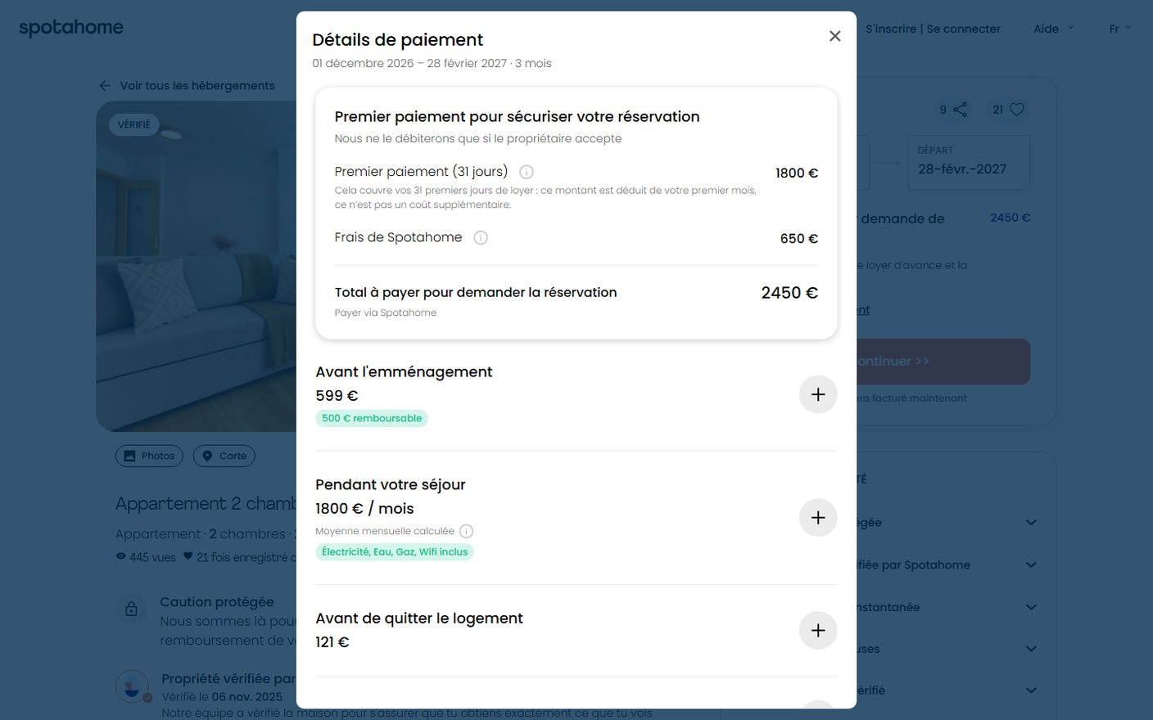
Walkthrough - real listing, Madrid
Shown at €1,800 a month, about €6,270 for three months
What you see, in order
1. "€1,800/month" on the result card.
2. "Select dates to see prices".
3. "Total to pay per request: €2,450", which "includes one month in advance and the Spotahome guarantee".
4. Opening the breakdown: €650 service fee, €599 before arrival, €121 at move-out.
The total for the stay is never added up. It is a help-centre article.
Spotahome · Booking without visiting · Working document
By Mayare Ouassou | 17

Slide 18
Rules and discourse - Guarantees against terms
The promise is written as certain, the rule as conditional
Measure
Guarantees page
Terms, section 7
Situation cited in reviews
Terms say
Certainty markers / 1,000 words
50
2.2
Paying more than the listed price
Minor
Conditions / 1,000 words
4.4
13.4
Landlord living there, unlisted
Minor
Words per sentence
≈ 15
40
Listed appliance missing
Minor
Flesch-Kandel readability
61 (standard)
≈ 28 (very hard)
Living with someone of another sex ("women only")
Not refundable
In the terms: "discretion" 42 times, "reserves the right" 54 times. At 250 words a minute, reading them takes about 2 hours.
Bedbugs
Significant: can cancel
Reading (Boltanski and Thévenot): the dispute is about how the situation is named. Only one party holds the categories, and applies them after the fact.
Spotahome · Booking without visiting · Working document
By Mayare Ouassou | 18

Slide 19
Content analysis - 60 listings, Madrid, Barcelona, Milan
The "Verified" label doesn't say what it proves, or since when
17 months
67 %
127
median age of the verification (27 of 39 over a year; oldest: 87 months)
warn of fees "not shown in this summary"
listings per "landlord" account in median: often an agency (39 pros, 21 private)
100 %
4 / 37
28 %
machine-translated; 17% keep passages in Spanish or Italian
shared rooms say who already lives there
refuse weekend arrivals; 27% ban address registration
Spotahome · Booking without visiting · Working document
By Mayare Ouassou | 19

Slide 20
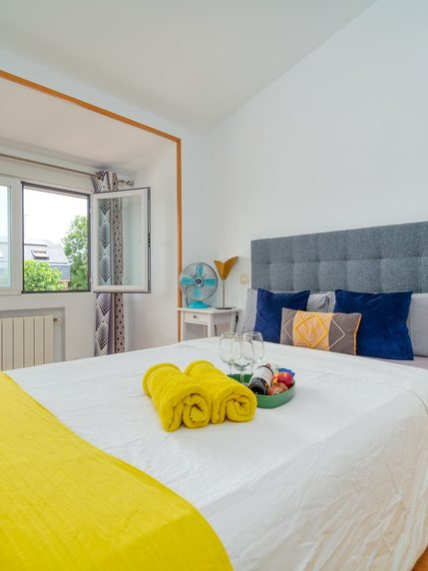
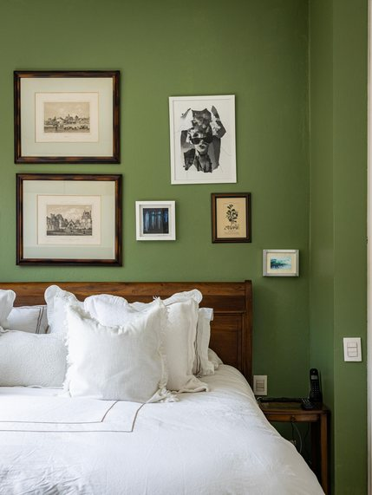
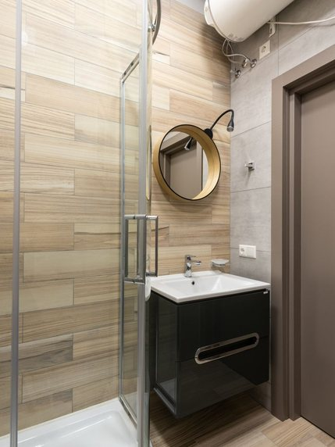
Visual semiology - photos of the 60 listings
Places without people: the photo sells a hotel room, not a shared flat
0 people visible across the 60 listings.
62 % open on the bedroom, never the street or shared areas.
8 listings at least stage folded towels and cushions, hotel-style.
1 listing uses photos marked "Example".
2 show a room still occupied by the current tenant.
60 % have a video tour: the device most cited in positive reviews.
Illustrative photos (Pexels), in the same register as the listings studied.
Reading: the photo answers "what does the room look like?", never "who will I live with?". That is exactly what shared-flat reviews complain about.
Spotahome · Booking without visiting · Working document
By Mayare Ouassou | 20

Slide 21
Benchmark - isomorphism
All competitors share the same device: the difference will be legibility
Platform
First payment
Tenant fee
What sets it apart
Spotahome
Held, paid to the landlord 48 h after arrival
€650 on the listing studied, non-refundable
Homecheckers and video tours
HousingAnywhere
Held, paid 48 h after arrival
€150 to €250 per its site, non-refundable
Listings from private owners and universities
Uniplaces
Held, paid after arrival
Non-refundable service fee
Students, Portugal and Spain
Wunderflats
Held, paid after arrival
Service fee
Employees, Germany
Reading (DiMaggio and Powell): under uncertainty, organisations in one field end up alike. All hold the payment and charge non-refundable fees: it isn't a competitive edge.
Spotahome can stand out through what no one does: state the total, date the verification, write the rule before payment.
Terms taken from the platforms' public pages on 7 October 2026; they may vary by city.
Spotahome · Booking without visiting · Working document
By Mayare Ouassou | 21

Slide 22
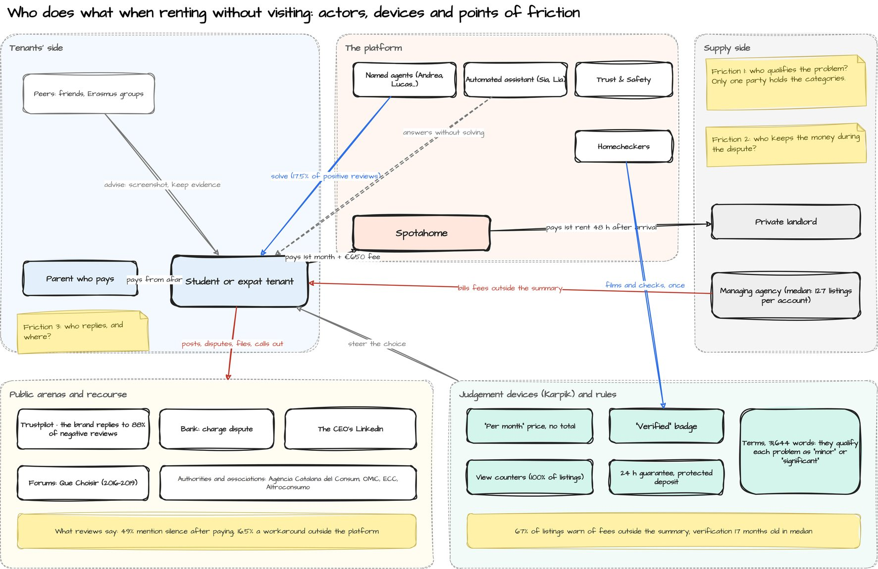
Mapping - actors and devices
Three friction points: who qualifies, who keeps the money, who replies
Spotahome · Booking without visiting · Working document
By Mayare Ouassou | 22

Slide 23
Ergonomic audit - Bastien and Scapin, 34 findings
Nine critical findings, all about money or control
No.
Critical finding
02
Price shown = rent only
07
"Verified": in person or remote, unsaid
09
No reviews of the home itself
14
Fees outside the summary on 67% of listings
15
Total for the stay never added up
19
Charged without the tenant confirming again
20
Multiple requests, no ranking
28
Guarantees promised, terms say otherwise
32
No case tracking after paying
Each finding carries the share of reviews mentioning it, and its screenshot. The full grid (Excel) gives criterion, sub-criterion, recommendation.
Spotahome · Booking without visiting · Working document
By Mayare Ouassou | 23

Slide 24
Ergonomic psychology - KLM and cognitive load
Finding the real price takes 52 seconds, 8 clicks and 5 sums
8 → 1
3 → 1
amounts to hold in mind, for a working memory of about 4 items (Cowan)
screens to check: card, summary, "See all payments" window
5 → 0
262 → 72 s
Execution time predicted by the KLM model for the task "find the cost of a 3-month stay" (listing 1497501)
mental sums: rent × 3, plus fees, minus the deposit
to compare 5 listings
The model describes an expert user who never errs: it's a lower bound. It already shows that the current site turns a reading into a calculation.
Spotahome · Booking without visiting · Working document
By Mayare Ouassou | 24

Slide 25
Ergonomic psychology - cognitive walkthrough
24 failures out of 40 questions, and no step without one
Step (profile: Erasmus student, on mobile)
Source
Q1 intention
Q2 visible action
Q3 action-effect
Q4 visible progress
Saisir ville et dates dans la recherche
observé
✓
✓
✓
✕
Comparer les annonces sur le prix
observé
✓
✓
✕
✕
Juger si l'annonce est fiable
observé
✓
✓
✕
✕
Choisir les dates sur l'annonce
observé
✓
✓
✓
✕
Trouver le coût total du séjour
observé
✓
✕
✕
✕
Poser une question au propriétaire
observé
✓
✕
✕
✕
Envoyer la demande
observé
✓
✓
✕
✕
Être débité après l'acceptation
reconstitué
✕
✕
✕
✕
Signaler un problème dans les 24 h
reconstitué
✓
✕
✕
✕
Récupérer le dépôt
reconstitué
✓
✕
✕
✕
Spotahome · Booking without visiting · Working document
By Mayare Ouassou | 25

Slide 26
Decision psychology - dark patterns, 60 listings
No fake urgency, but a split price and constant social proof
100 %
100 %
67 %
show views, saves and "interested". Never zero interested; 9.5 in median. Social proof (Cialdini).
hide the stay price until dates are chosen; the "/month" acts as an anchor (Tversky and Kahneman).
push fees "not shown in this summary": partitioned price and late costs (Morwitz).
48 %
23 %
0 %
charge an admin fee, one month's rent in median; 19 listings give it as a percentage, to compute yourself.
add a monthly bills package shown without an "extra" label; 20% show a "from" rent.
use a countdown or fake scarcity: the pressure comes from numbers, not the clock.
Spotahome · Booking without visiting · Working document
By Mayare Ouassou | 26

Slide 27
Accessibility - WCAG 2.1, axe-core
340 defects detected automatically on 5 pages, 223 of them critical
Reading
A screen reader announces "button" without saying which on every card: you can't save a home or browse photos without seeing the screen.
An automated test only finds part of the defects: these figures are a floor.
13 WCAG 2.1 A and AA rules failed; home, results, listing, guarantees, how it works; 1440 and 390 px (7 October 2026)
Spotahome · Booking without visiting · Working document
By Mayare Ouassou | 27

Slide 28
Trust model - Mayer, Davis, Schoorman
Trust breaks on integrity; no one praises honesty
1-2 star Trustpilot reviews touching each dimension (one review can touch several)
4-5 star reviews (relief = ability, named agent = benevolence)
Reading: Spotahome is blamed for not keeping its word (76.5%) before being blamed for silence (56.5%). Happy customers say "it works", never that it's honest. The redesign must make the promise checkable, not just more reassuring.
Spotahome · Booking without visiting · Working document
By Mayare Ouassou | 28

Slide 29
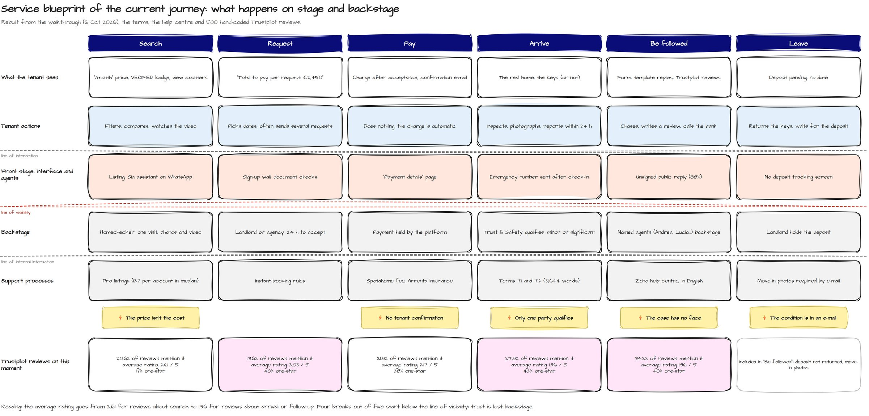
Service blueprint - front stage and backstage
Four breaks out of five start below the line of visibility
Spotahome · Booking without visiting · Working document
By Mayare Ouassou | 29

Slide 30
Narrative analysis - Labov, 60 one-star stories
Stories without an ending: the complication is almost never resolved
92 %
73 %
58 %
of stories have no resolution; 5% a partial one, almost always after the platform stepped in.
are still open when written: the author is waiting for a refund, a deposit, a reply.
end with a warning to future tenants: the coda replaces the resolution.
25 %
18 %
67 %
speak directly to the brand, case number included: the review serves as a help desk.
announce external recourse: bank, European Consumer Centre, courts.
use moral vocabulary ("scam", "theft", "lie") rather than technical.
Spotahome · Booking without visiting · Working document
By Mayare Ouassou | 30

Slide 31
Document readings - homecheckers and terms
"Verifying" means filming; the rules let the platform judge alone
What a homechecker does, per 4 public texts
A freelance photographer job: photos, narrated video, floor plan, free hours, B2 English and a recent smartphone.
None of the texts mentions checking condition, safety, locks or occupants.
This doesn't prove there's no internal checklist, but tenants can't know it.
Terms clause (extract)
Consumer Code
modification unilatérale des clauses du contrat
R212-1, 3° (noire) et R212-2, 6° (grise)
modification unilatérale des caractéristiques du service
R212-1, 3° (noire)
droit exclusif de déterminer si le service est conforme ou d'interpréter le contrat
R212-1, 4° (noire)
évaluation de la conformité par le seul professionnel
R212-1, 4° (noire)
interdiction de demander la résolution en cas d'inexécution
R212-1, 7° (noire)
suppression du droit à réparation
R212-1, 6° (noire)
limitation des moyens de preuve
R212-2, 9° (grise)
Terms: 7 clauses found, 6 matching the black list (art. R212-1). "Reserves the right" appears 53 times. A reading grid, not legal advice.
Spotahome · Booking without visiting · Working document
By Mayare Ouassou | 31

Slide 32
03
Define
Six insights, five principles, one concept: "Nothing hidden".
· Insights
· Design principles
Spotahome · Booking without visiting · Working document
By Mayare Ouassou | 32

Slide 33
Synthesis - insights
Six insights, each backed by data and a theoretical reading
01 · Temporalities
02 · Walkthrough
03 · Karpik
The rating measures when the platform is present
The price is a puzzle
The label doesn't say what it proves
The total is never added up; the fee becomes a "guarantee"
In person or remote, 17 months median
Relief at booking (72%), silence after (49%), negative reviews 5 days later
04 · Boltanski, Thévenot
05 · Akrich, Hirschman
06 · Giddens, Goffman
The dispute is a fight over naming
When the platform is silent, users work around it
Trust has a face
Paying more, or living with the landlord: "minor"
17.5% of positive reviews name an agent; 0% of replies are signed
The public review becomes a help desk: 88% get a reply
Spotahome · Booking without visiting · Working document
By Mayare Ouassou | 33

Slide 34
Principles - "Nothing hidden" concept
Five rules for the redesign, within Spotahome's existing brand
1
One number, the real one
The total for the stay wherever a price appears: cards, listing, map, sort, budget.
2
Every signal says what it covers
Visited in person or checked remotely, when, and what wasn't checked.
3
The rule before the promise
What lets you cancel, get a repair, or nothing: written before paying.
4
The tenant keeps control
They rank their requests and confirm before any charge.
5
Stay present after payment
A case, a name, a deadline, a due date for the deposit.
Spotahome · Booking without visiting · Working document
By Mayare Ouassou | 34

Slide 35
04
Develop · Deliver
Eleven wireframes, eleven mockups, one clickable prototype.
· Target journey in wireframes
· Desktop mockups
· Mobile mockups
· Recommendations
Spotahome · Booking without visiting · Working document
By Mayare Ouassou | 35

Slide 36
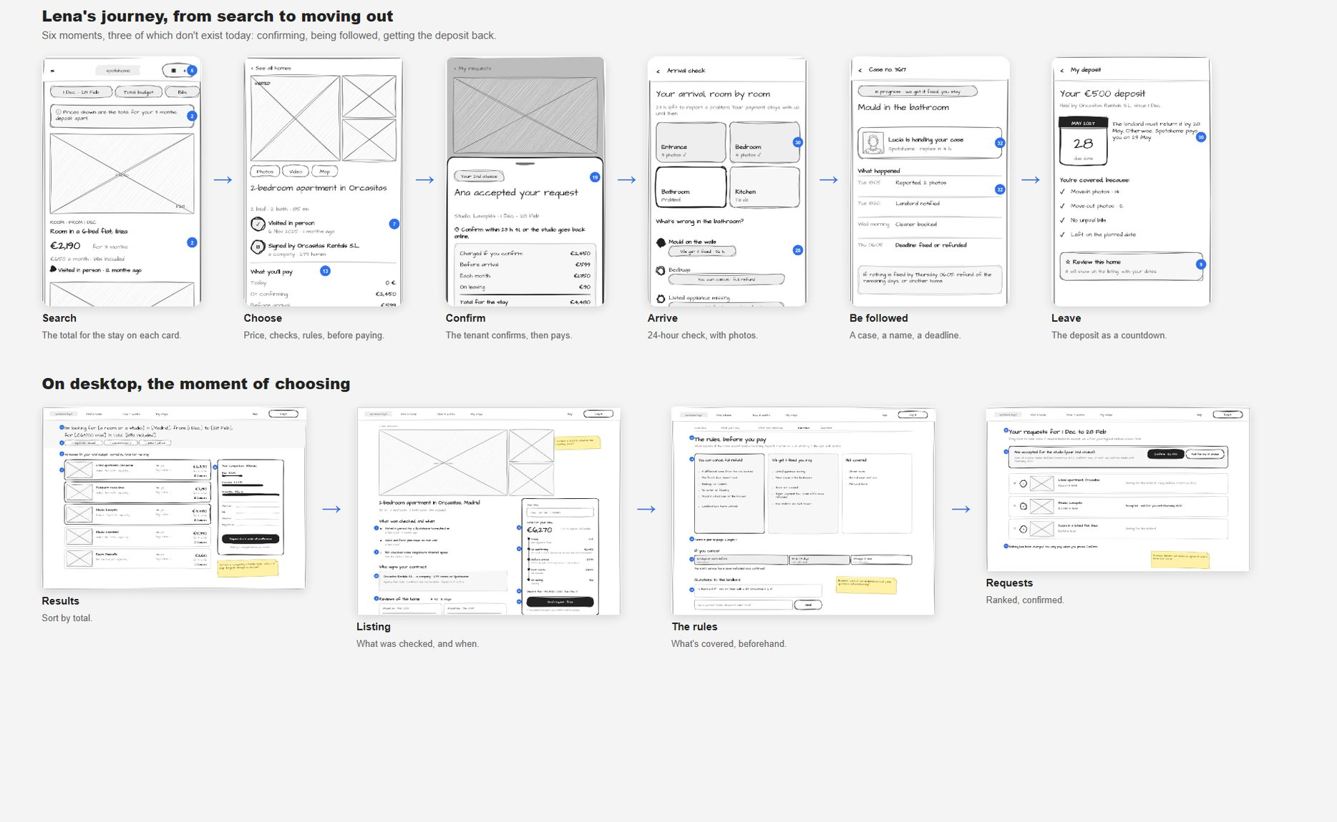
Develop - wireframes
Eleven screens drawn in draw.io, from choosing to moving out
Spotahome · Booking without visiting · Working document
By Mayare Ouassou | 36

Slide 37
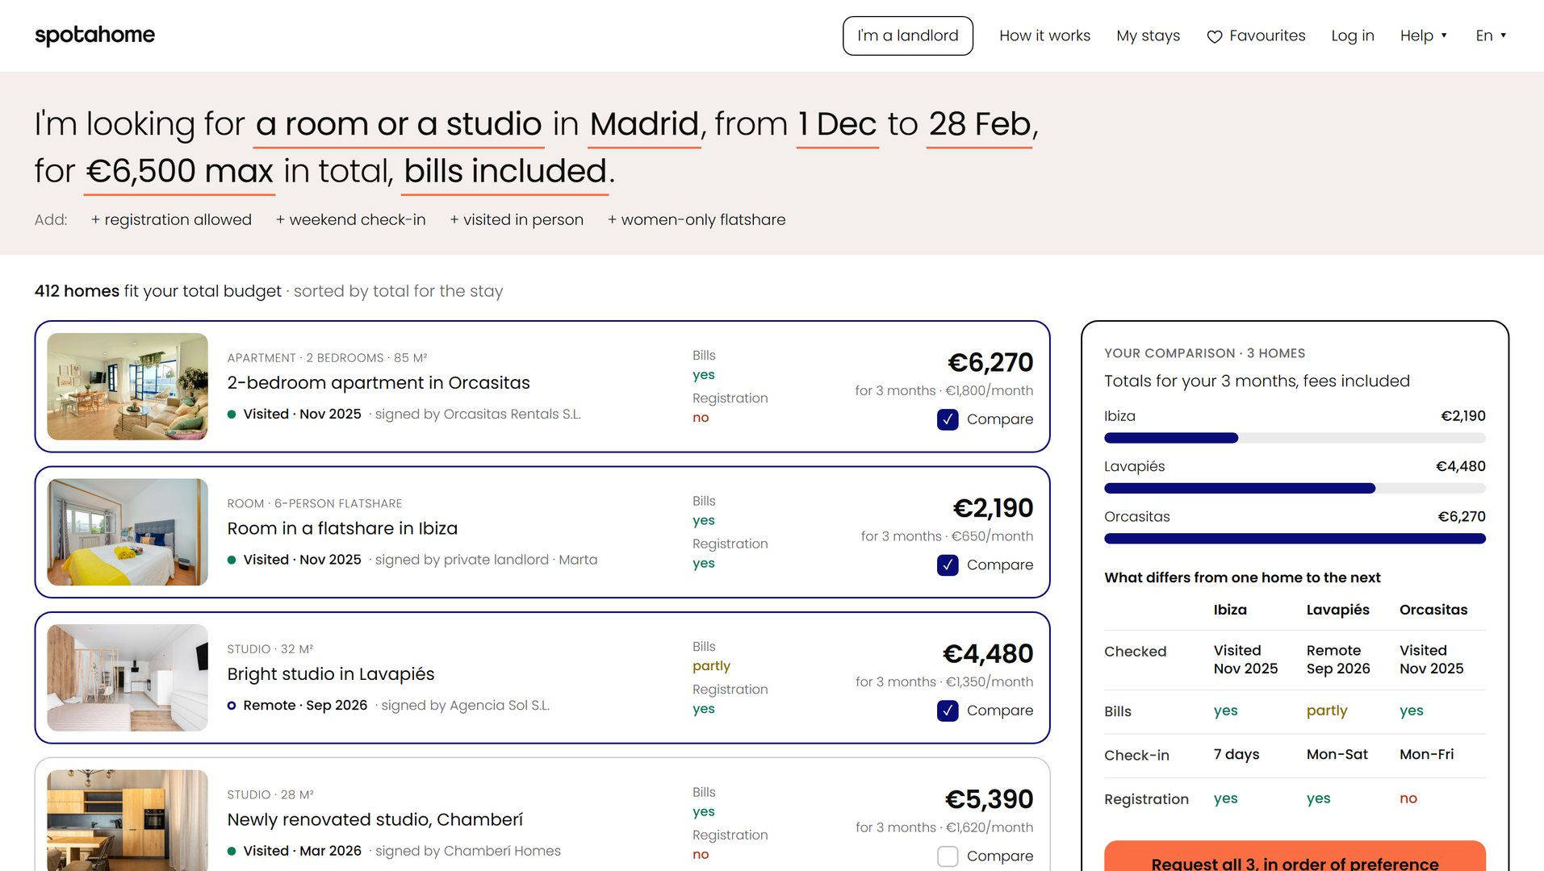
Deliver - results
A search that speaks in total for the stay, not rent
Fixes
02 · price and budget on the total
06 · bills, registration, weekend filters
03, 07 · dated verification and signer on each row
20 · comparison and ranked requests, no map alongside
Spotahome · Booking without visiting · Working document
By Mayare Ouassou | 37

Slide 38
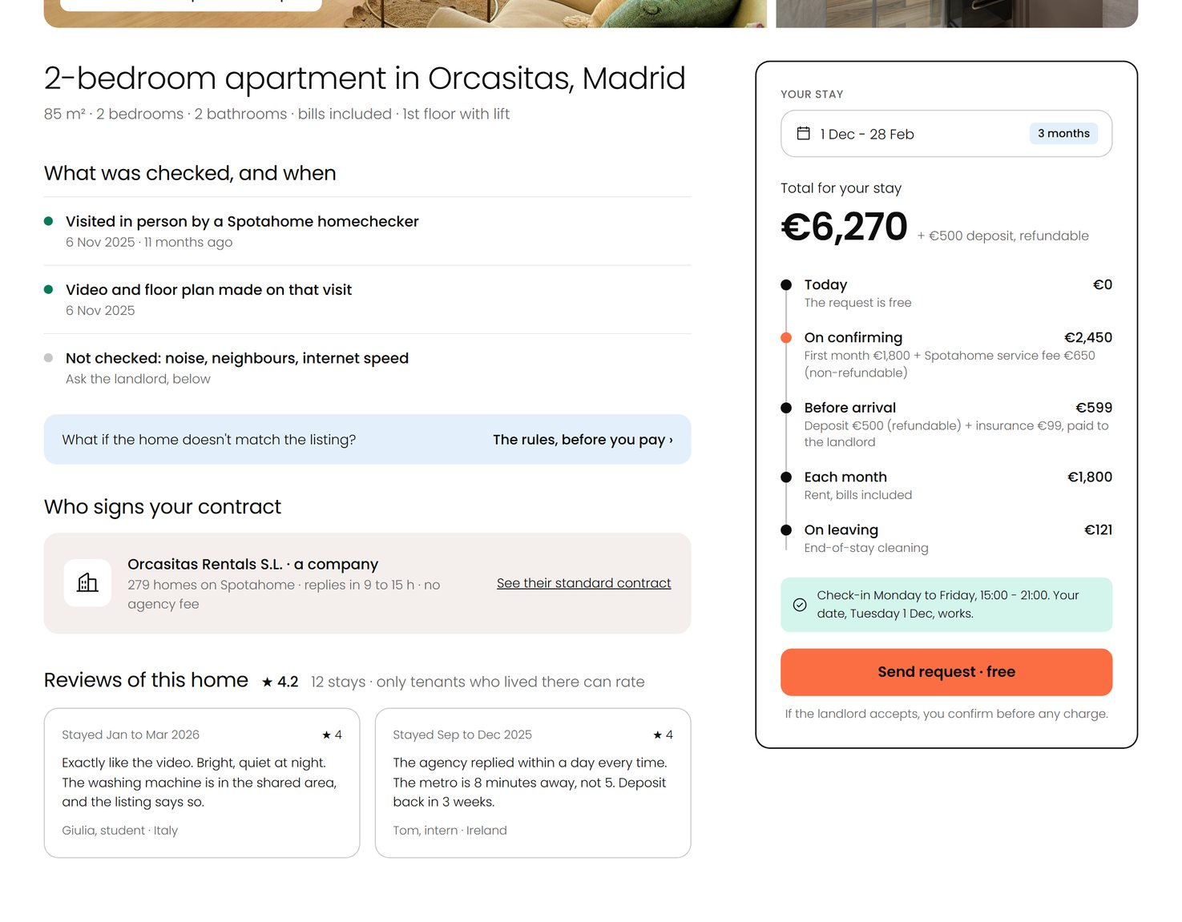
Deliver - listing
The total, what was checked, and who signs the contract
Fixes
15 · total split by moment
16 · fee named, non-refundable
07, 08 · checked when, and what wasn't
24 · who signs the lease
09 · reviews of the home
19 · free request, confirmation before charge
Spotahome · Booking without visiting · Working document
By Mayare Ouassou | 38

Slide 39
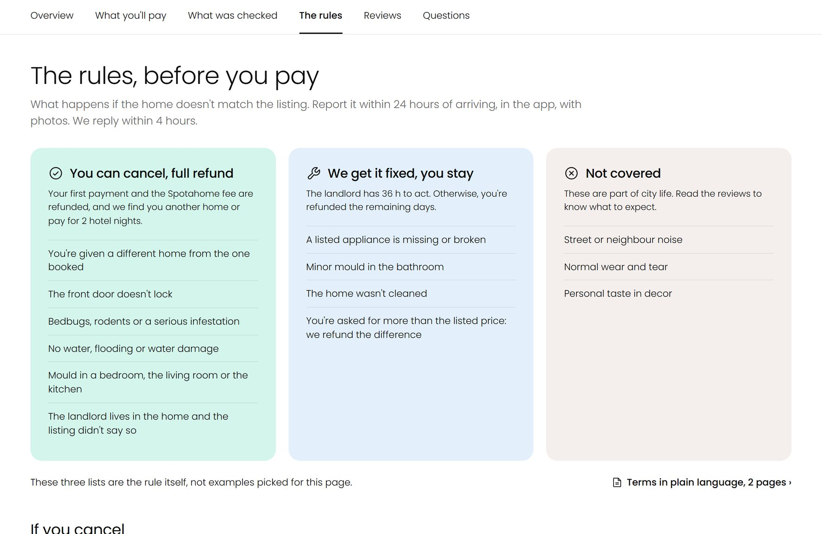
Deliver - the rules
The rule shown where the promise is made
Fixes
28 · guarantees and terms reconciled
34 · unlisted resident landlord: can cancel
29 · terms in two pages
21 · public questions before paying
Spotahome · Booking without visiting · Working document
By Mayare Ouassou | 39

Slide 40
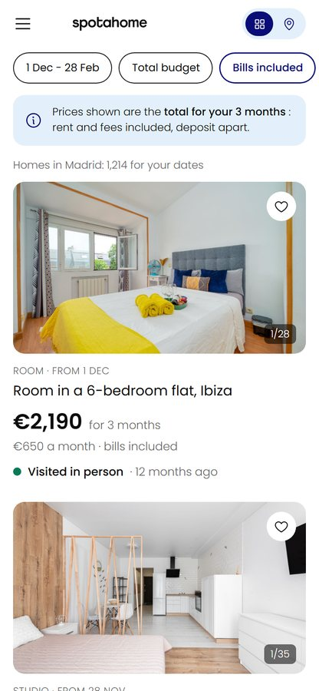
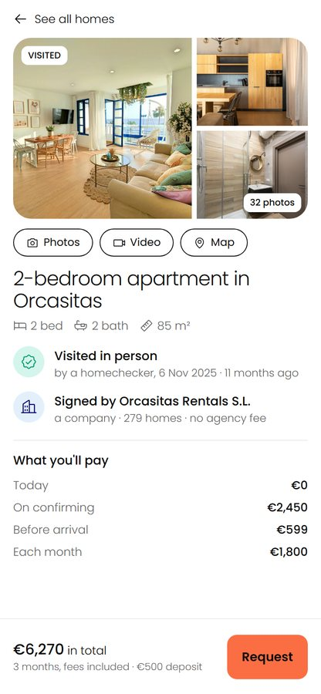
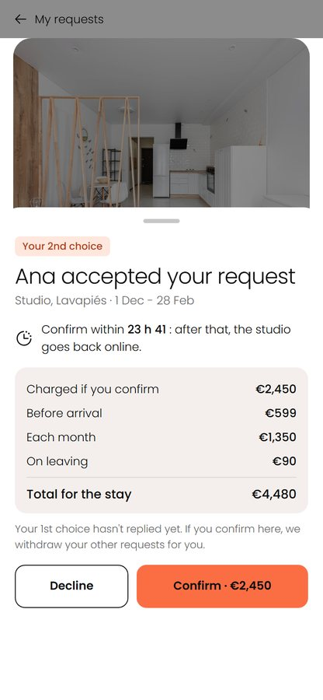
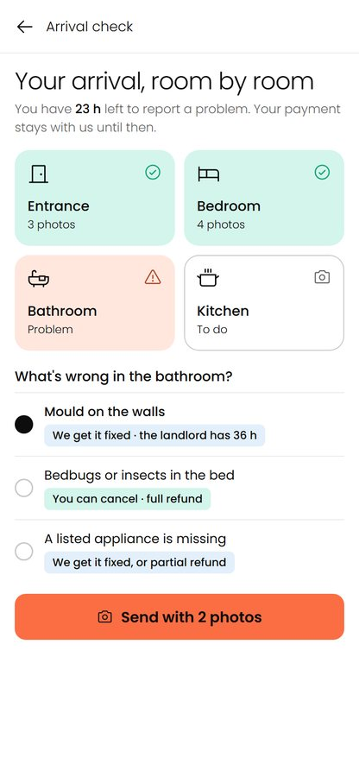
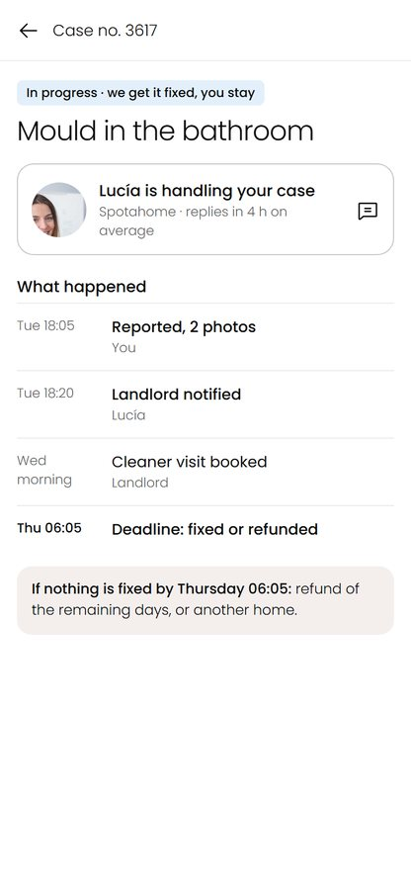
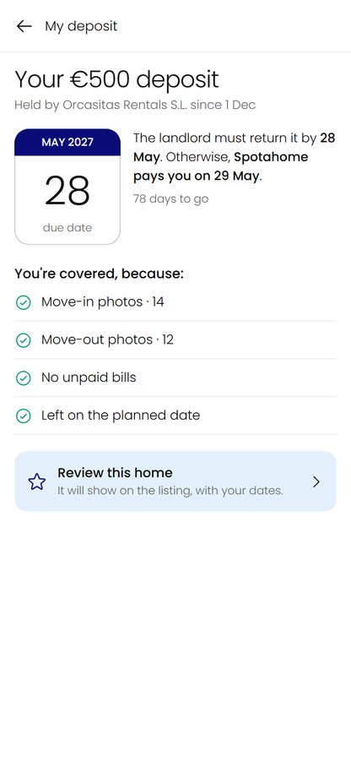
Deliver - mobile
Six moments, three of which don't exist today
Search
Choose
Confirm
Arrive
Be followed
Get the deposit back
Spotahome mobile codes kept: photo collage, icon info cards, list and map toggle. New: confirmation sheet, room-by-room arrival check, dated case, deposit due date.
Spotahome · Booking without visiting · Working document
By Mayare Ouassou | 40

Slide 41
Evidence - before / after, same tools
Measured with the same tools, the redesign addresses the defects found
Measure
Current site
Redesign
Change
Bastien and Scapin: severity score (critical 3, major 2, minor 1)
64
10.0
-84%
Critical findings not fixed
9
0
Cognitive walkthrough: failed questions out of 40
24
0 (+2 to test)
KLM: seconds to find the cost of 3 months
52.3
14.5
-72%
Accessibility: WCAG defects found by axe-core
340
0
Dark patterns found on listings
6
0
Bastien and Scapin: 23 findings fixed, 3 partly, 5 not addressed (listing translation, sign-up wall, map navigation in the app, flatmates, area text). Accessibility measured on the HTML mockups: it only covers what they contain.
Limit: the evaluator is also the designer. These measures show the redesign addresses the defects; only a test with people will tell whether it's understood.
Spotahome · Booking without visiting · Working document
By Mayare Ouassou | 41

Slide 42
Evidence - what changed in the brand
An accessibility choice: the brand orange keeps black text
Why this choice
Darkening the orange to reach 4.5 with white would have made it brick-red: the brand would change. Keeping the exact orange and switching text to black respects both the brand and the standard.
Same logic for card hearts and arrows: real named buttons ("Save to favourites", "Next photo").
Send request
Send request
Current site: white on orange, contrast 2.83 (WCAG asks 4.5)
Redesign: black on the same orange, contrast 6.86
Spotahome · Booking without visiting · Working document
By Mayare Ouassou | 42

Slide 43
Recommendations - priorities
Where to start: high impact and low effort first
Action
Impact
Effort
Findings
Total for the stay on cards and listing
High
Low
02, 14, 15
Badge saying in person or remote, and the date
High
Low
07, 08
Tenant confirmation before charge
High
Medium
19
Rules in three columns, aligned with the terms
High
Medium
28, 29, 34
Tracked case with a named contact
High
High
32
Public replies signed by a person
Medium
Low
replies
Admin fee in euros, included in the total
High
Low
dark patterns
Accessible names for card buttons (heart, arrows)
Medium
Low
WCAG 4.1.2
Requests ranked by the tenant
Medium
High
20
Dated reviews per home
Medium
Medium
09
Spotahome · Booking without visiting · Working document
By Mayare Ouassou | 43

Slide 44
05
Validate and next steps
What still needs checking with real people.
· Hypotheses and ready-made tools
· Limits
Spotahome · Booking without visiting · Working document
By Mayare Ouassou | 44

Slide 45
Validate - hypotheses
Six hypotheses, three tools ready to run
H1
Finding the real cost after requesting tips trust over
Interview guide
H2
"Verified" is read as "recently visited"
8 people, 60 min. Comprehensive interview, photo-elicitation on real listings, sorting 10 "does it count?" cards against the terms.
H3
Before arriving, people don't know what lets them cancel
H4
Without visible tracking, people turn to workarounds
Test guide
H5
Fear of having nowhere pushes blind requests
8 people, 45 min, 5 tasks, current site against prototype. Target: total estimated within €50, 80% success without help.
H6
A named contact matters more than written guarantees
Survey
22 questions, 7 minutes, 300 answers targeted including 100 via Spotahome, to measure H1 to H6 at scale.
Spotahome · Booking without visiting · Working document
By Mayare Ouassou | 45

Slide 46
Limits - and next steps
What this research doesn't say, and what to do next
Limits
Reviews over-represent extremes, and some positive reviews are solicited.
Reddit could not be collected (access denied).
The journey after sign-up is rebuilt from the terms, help centre and reviews, not observed.
The benchmark relies on competitors' public pages.
No interview, test or survey was run: the profiles are ideal types, not people.
Next steps
1. Run the 8 interviews and the card sort.
2. Send out the survey.
3. Test the prototype against the current site.
4. Ship the total for the stay and the dated badge first: low effort, high impact.
5. Track four metrics: share of 1-star reviews, chargebacks, reply time after payment, gap between price shown and paid.
Spotahome · Booking without visiting · Working document
By Mayare Ouassou | 46

